Slide 1
RETAIL SALES CAPSTONE PROJECT
GROUP 1 – ABADS – BATCH 10 – HERO VIRED

Slide 2
Table of contents
01
02
03
04
05
06
Understanding Data
Bivariate & Multivariate Analysis
Cleaning, Outlier Detection, Feature Creation & Binning
Generating Insights
Hypothesis Testing
Creating Clusters & its Analysis

Slide 3
01
UNDERSTANDING DATA
The dataset provided by the leading retail giant contains comprehensive information about customers, their demographics, purchase behavior, and responses to marketing campaigns.

Slide 4
DATA SET COMPONENTS
DEMOGRAPHICS | The dataset includes demographic information such as Year_Birth (customer's birth year), Education (education level), Marital_Status (marital status), Income (yearly household income), Kidhome (number of children in the household), Teenhome (number of teenagers in the household), Dt_Customer (date of customer enrollment), and Country (customer's location).
PURCHASE BEHAVIOUR | It encompasses data related to customer purchase behavior, including variables like Recency (number of days since the last purchase), Amount spent on various product categories (e.g., wines, fruits, meat products), Number of deals, web, catalog, and store purchases, as well as the number of web visits in the last month.
MARKETING CAMPAIGNS | The dataset also includes information about customer responses to various marketing campaigns, represented by binary variables like AcceptedCmp1 to AcceptedCmp5 and the Response variable, indicating whether the customer responded positively to the last campaign.

Slide 5
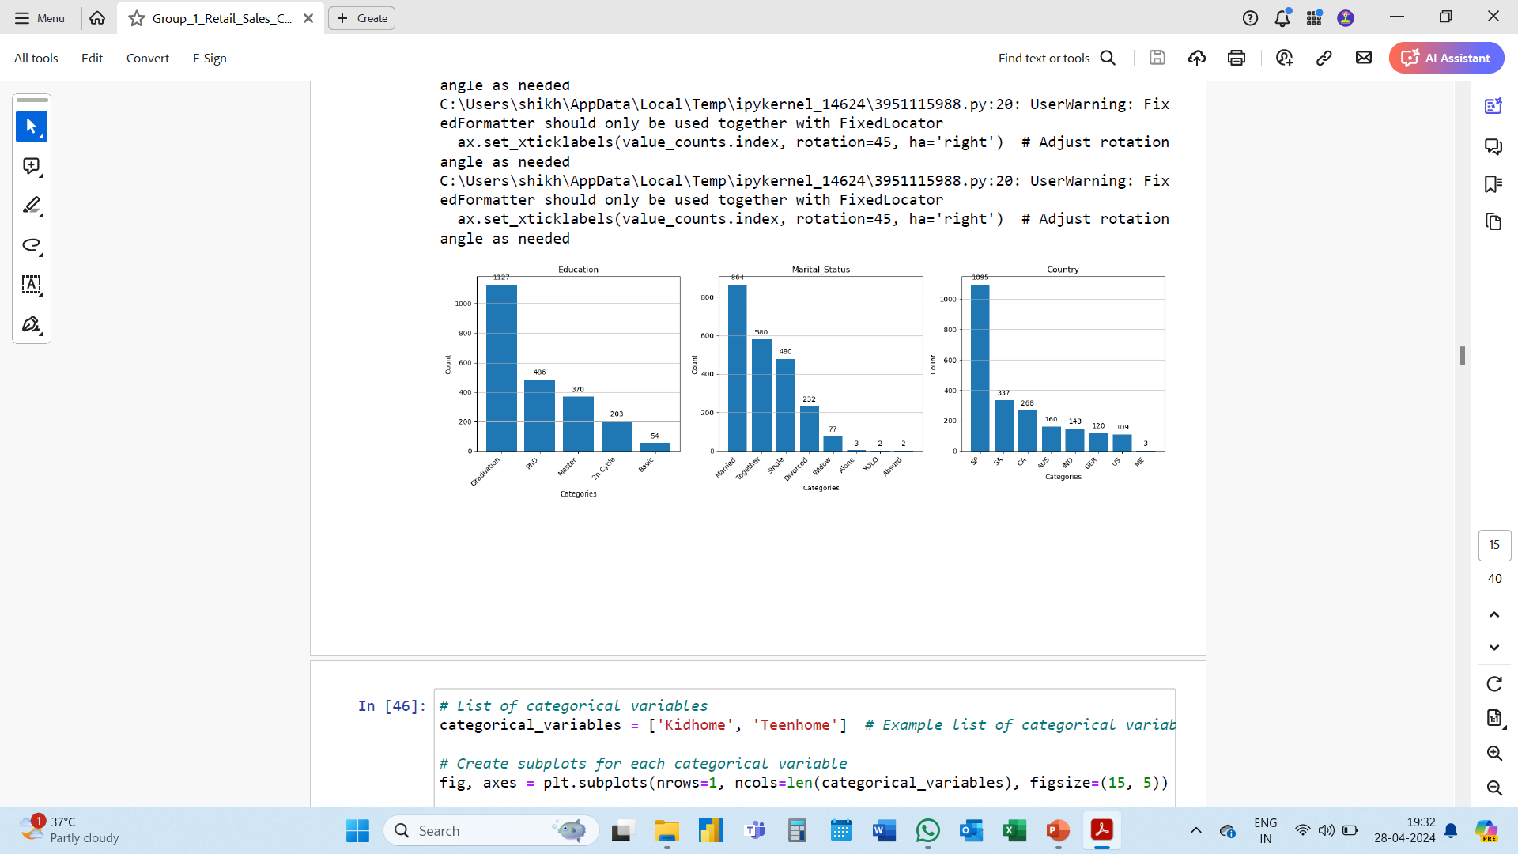
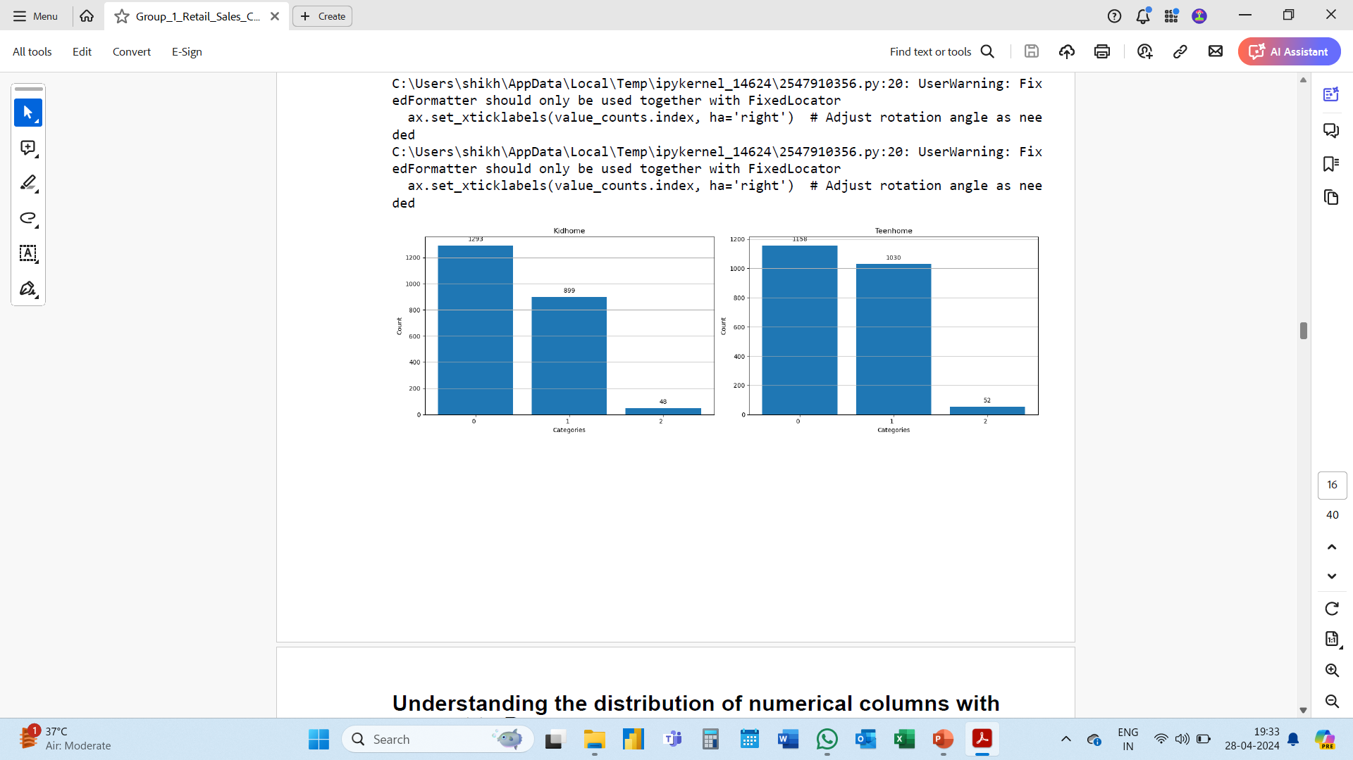
DEMOGRAPHICS

Slide 6
DEMOGRAPHICS
We can see the distribution of values over categories for each categorical column.
Education – most of the customers are graduate.
Marital Status – A big number of customers are married.
Country – almost 50% of total customers are from SP country
More than 50% of our customers don’t have a kid or teen @ home.

Slide 7
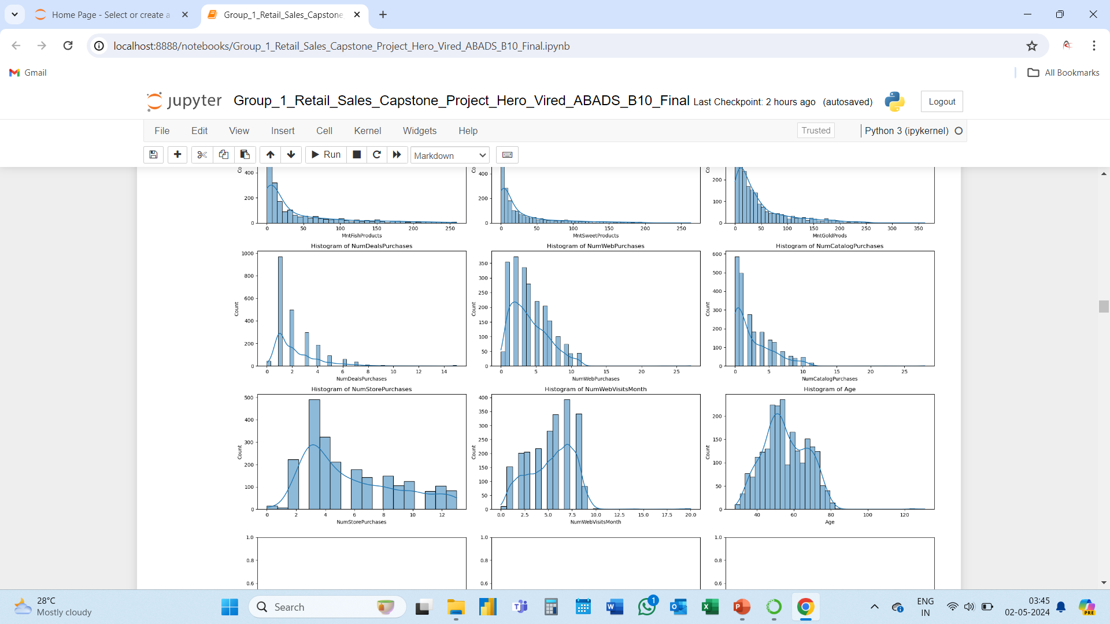
PURCHASE BEHAVIOUR

Slide 8
PURCHASE BEHAVIOUR
Purchase Behaviour.
Deals – The highest number of customers have purchased only 1 deal.
Web – The highest number of customers have purchased aprox. 1 to 4 items through web.
Catalogue – Most of the customers buy between 1 to 4 items through this channel.
Store - significant number of customers have bought higher number of items through store.
All the graphs are right skewed except for web visits.

Slide 9
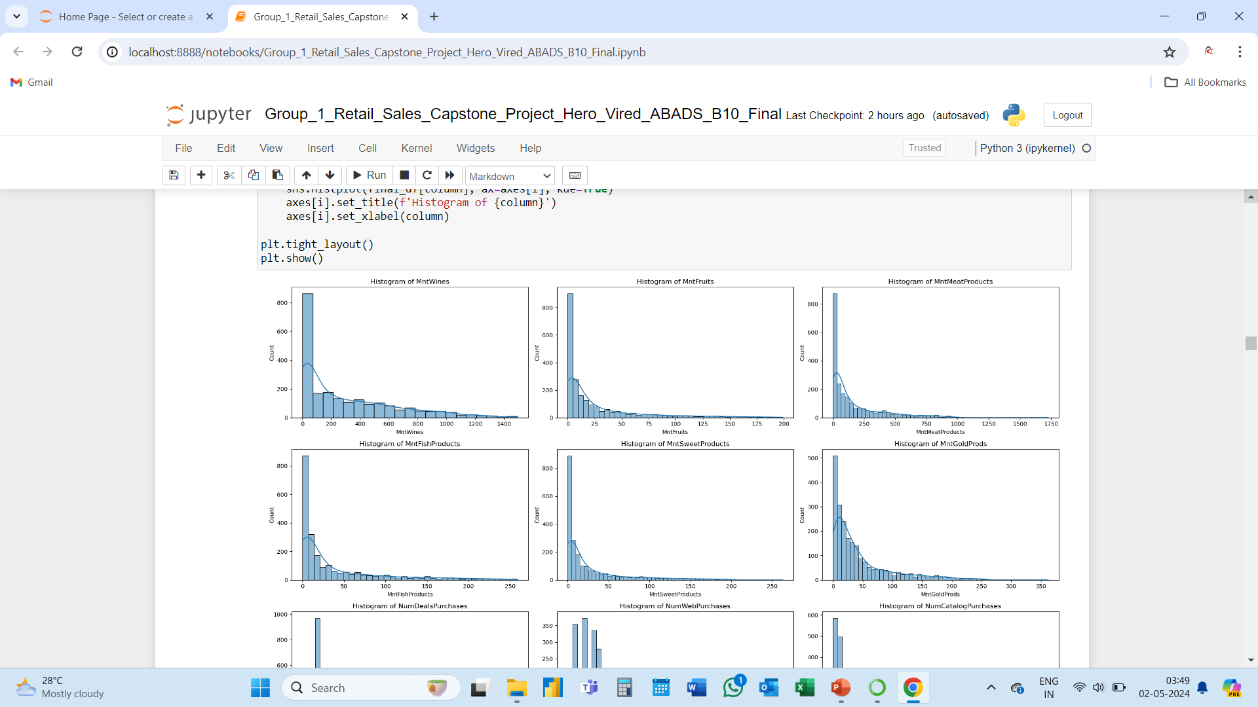
PURCHASE BEHAVIOUR

Slide 10
PURCHASE BEHAVIOUR
Purchase Behaviour.
Wines, Fruits, Meat, Fish & Sweet. – There’s a lot of scope to increase the sale of these products as around 800 to 850 customers have not bought any 1 or more of the above product.
Gold – Out of the total 2240 customers 500 customers have not bought the Gold product so far.
All the graphs are right skewed.

Slide 11
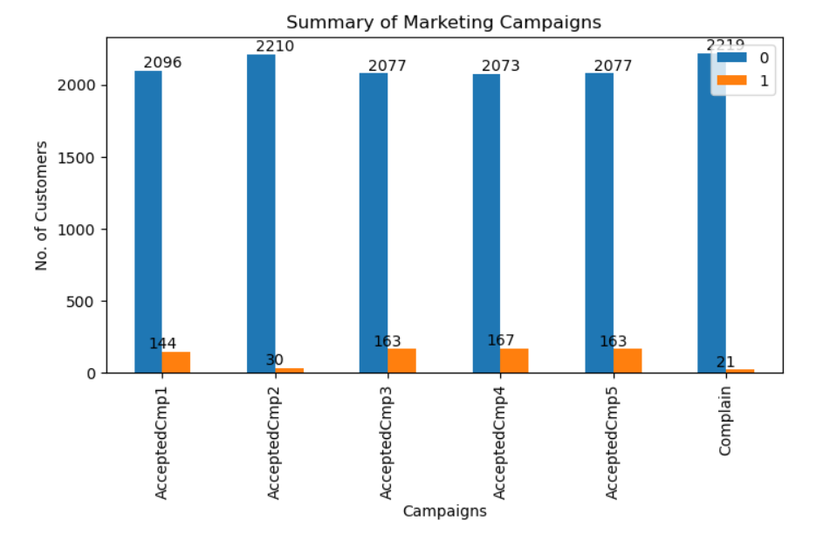
MARKETING CAMPAIGN

Slide 12
MARKETING CAMPAIGN
Campaign Performance
Campaign 2 – was the least performing campaign as it had only 30 positive response. Further data should be collected and analysed to find the reason of its failure and to avoid such instances in future.
Campaign 3, 4, 5 – all these three campaigns have almost equal positive response, steps should be taken to increase these positive response in the upcoming campaign.

Slide 13
02
Cleaning, Outlier Detection & Feature Creation

Slide 14
Cleaning, Outlier Detection, Feature Creation & Binning
Cleaning Data :
Fixed the ID Column to merge data,
Removed $ and , from the Income Column,
Fixed the Response Column
Outlier Detection :
Box plot was created to detect outliers.
These Columns had outliers : 'Income', 'MntWines', 'MntFruits', 'MntMeatProducts’, 'MntFishProducts', 'MntSweetProducts', 'MntGoldProds’.
Feature Creation :
A new column was created named “Total_Amount_Spent” where all the amounts of product categories was summed.
Similarly a column named “Total_Purchases” was created where purchases from all sales channels were summed.
Binning :
Income_Bin was created for better understanding of customers with different income groups.
Similarly Age_Bin was created to understande the age group of different customers.

Slide 15
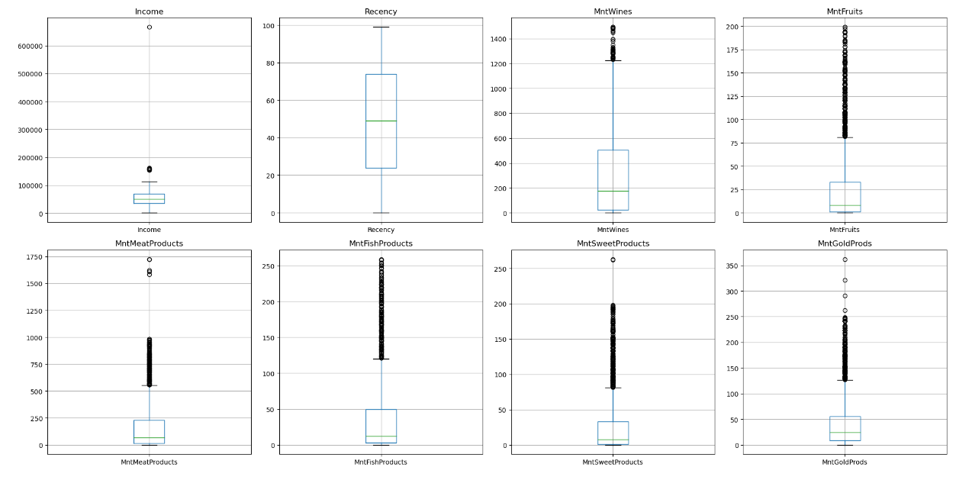
Outlier Detection

Slide 16
Outlier Detection
Fruits, Fish & Sweet products have a significant number of outliers.
Next comes the Gold and Meat products.

Slide 17
03
Univariate, Bivariate & Multivariate Analysis

Slide 18
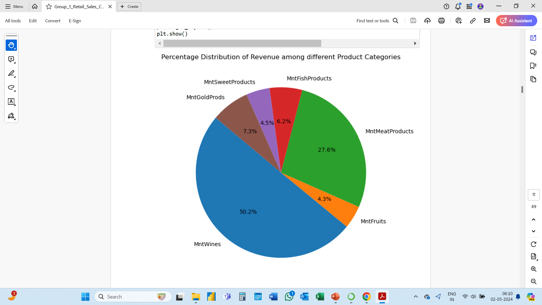
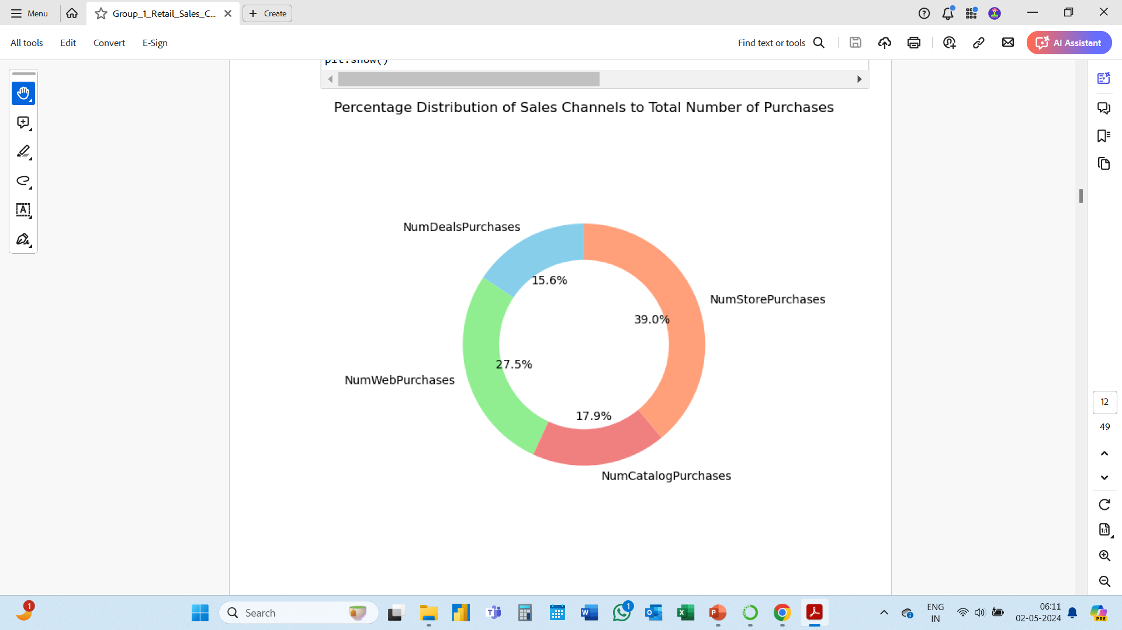

Slide 19
Wine is the highest selling product for the store covering about 50% of total sales.
Meat is second highest selling product @ 27.6% of total sales.
Store – This is the most preferred channel for sales covering about 39% of total purchases.
Web is second highest selling product @ 27.5% of total purchases.

Slide 20
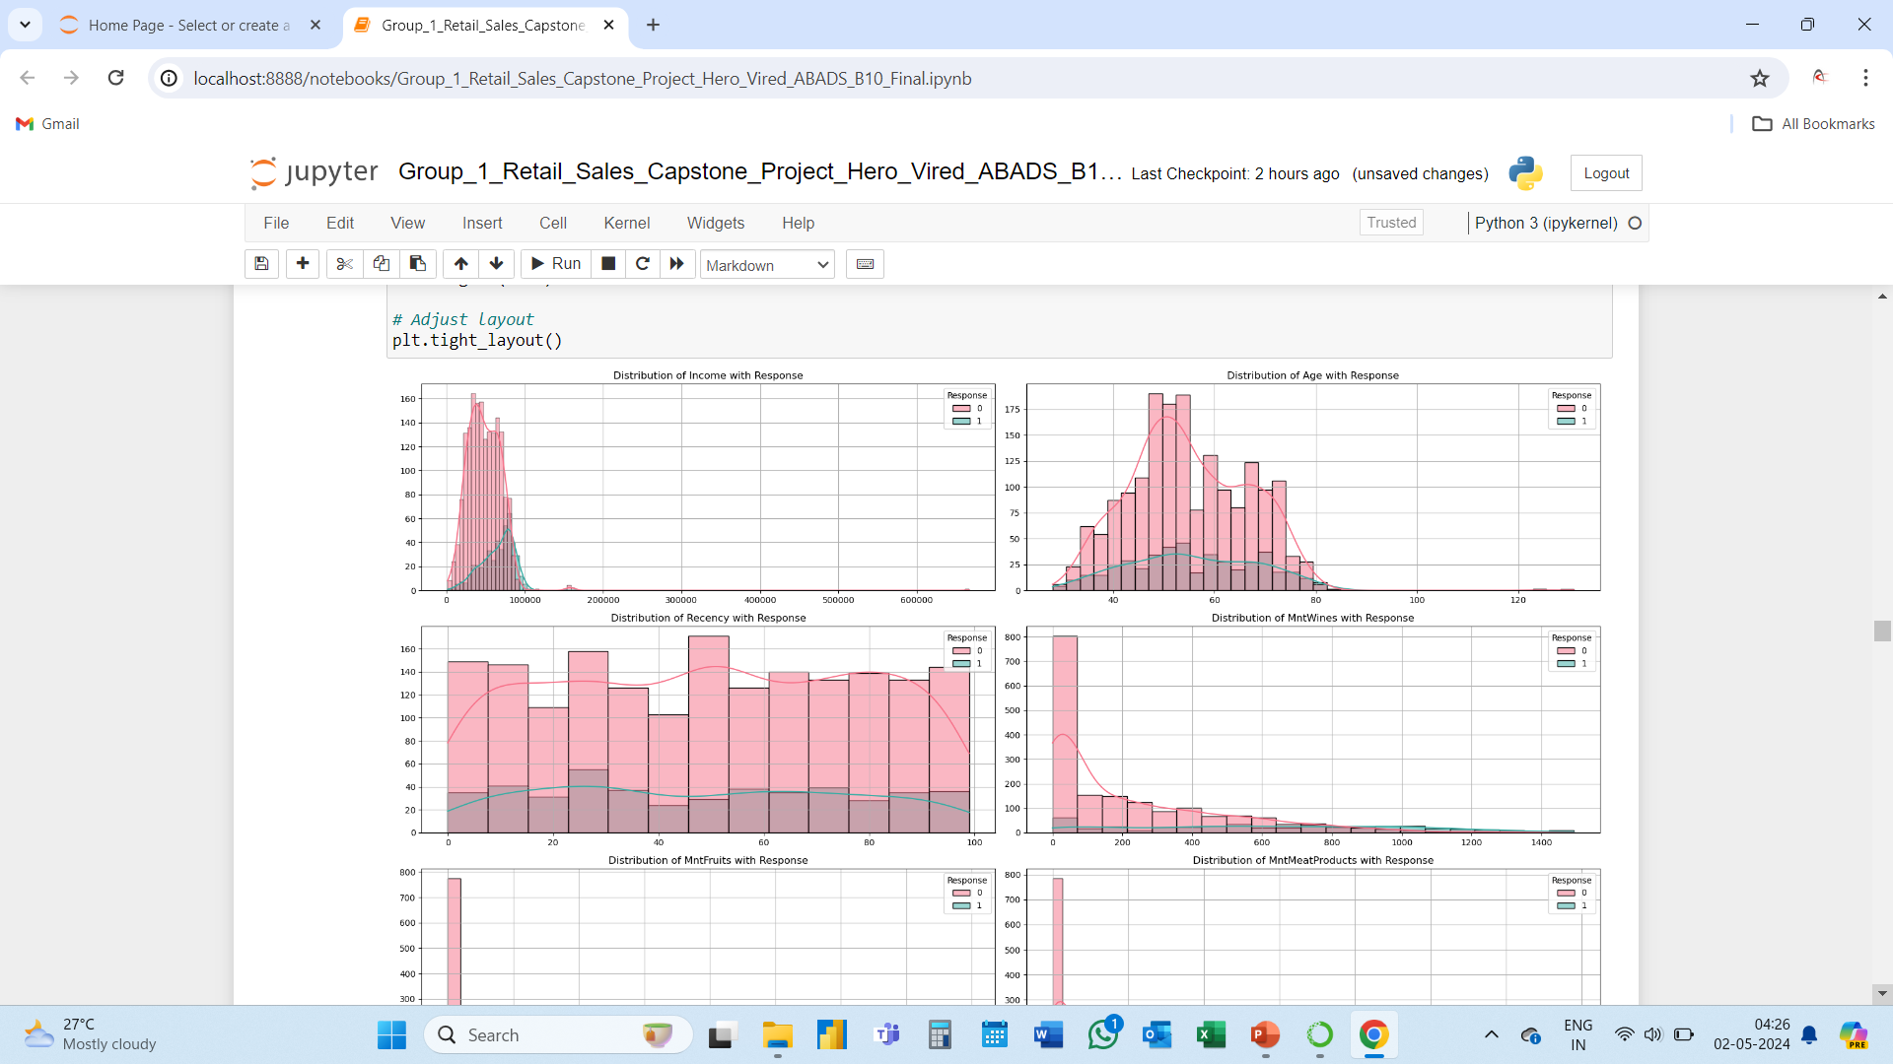

Slide 21
Income v/s Response – Higher number of positive response is seen in the income group of $50K to $100K.
Age v/s Response – There is a spike in positive response from age 50 to 57. then @ 60 and @70.
Recency v/s Response – Recency is mostly flat, except for a significant spike towards positive response at approx. 25 days.
Wines v/s Response – Almost all customers who spent more than $700 on Wines have replied positively to the campaigns.

Slide 22
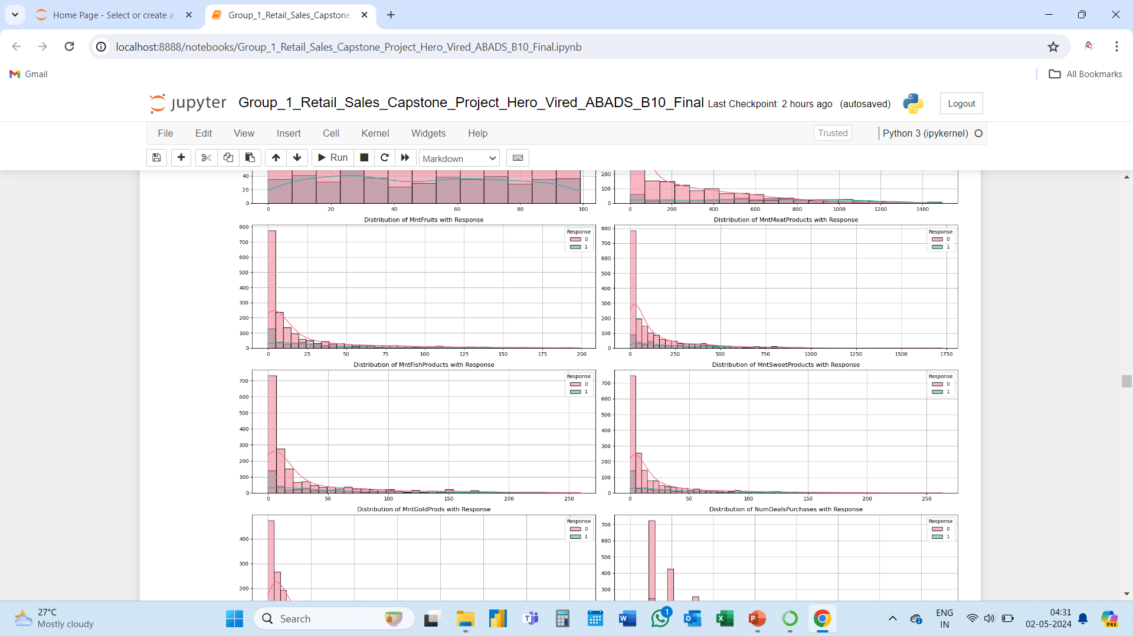

Slide 23
Amount spent on products like Fruits, Meat, Fish and Sweet has comparatively lower impact on responses as compared to Wines in previous slide.
No significant spikes are seen.

Slide 24
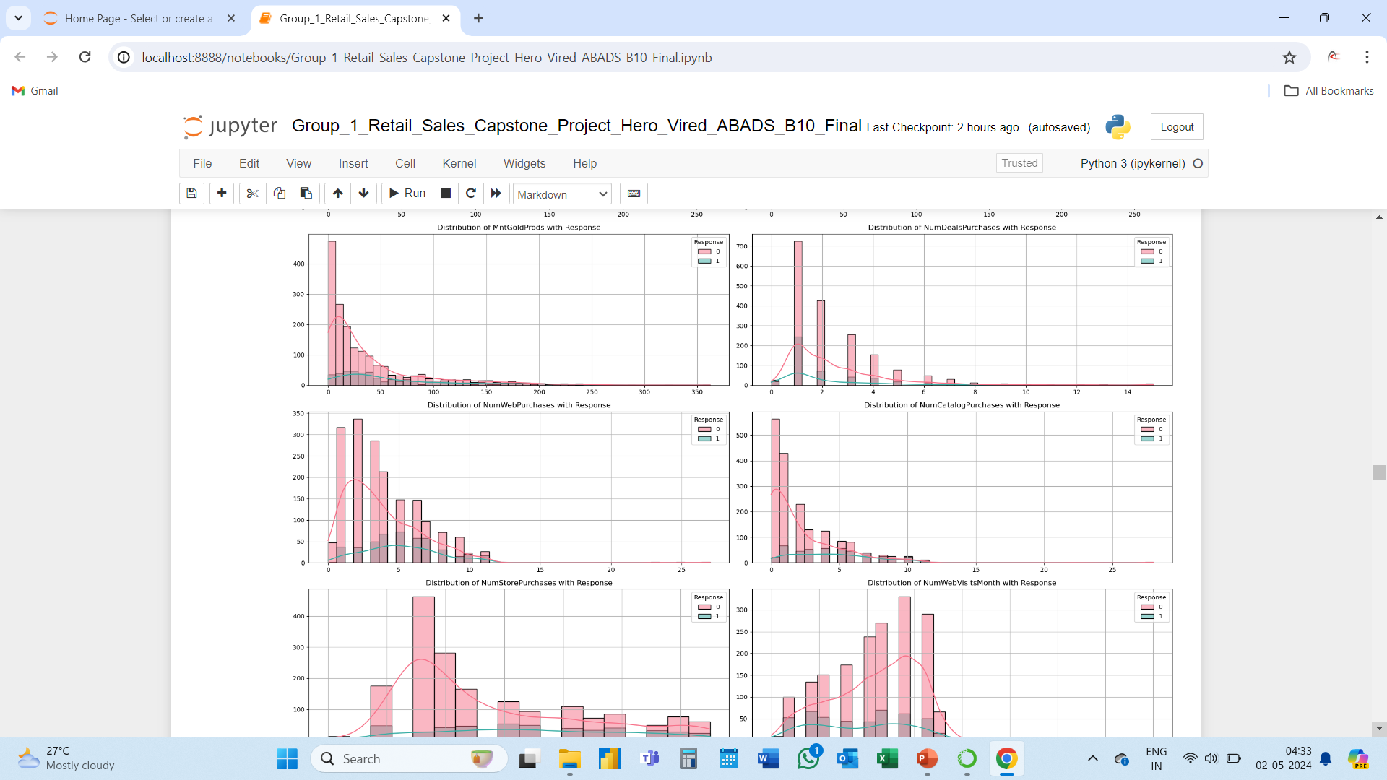

Slide 25
There is a visible rise in positive response among customers who have bought 3 to 6 products through web.
Similarly for people who have more than 3 items through catalogue.

Slide 26
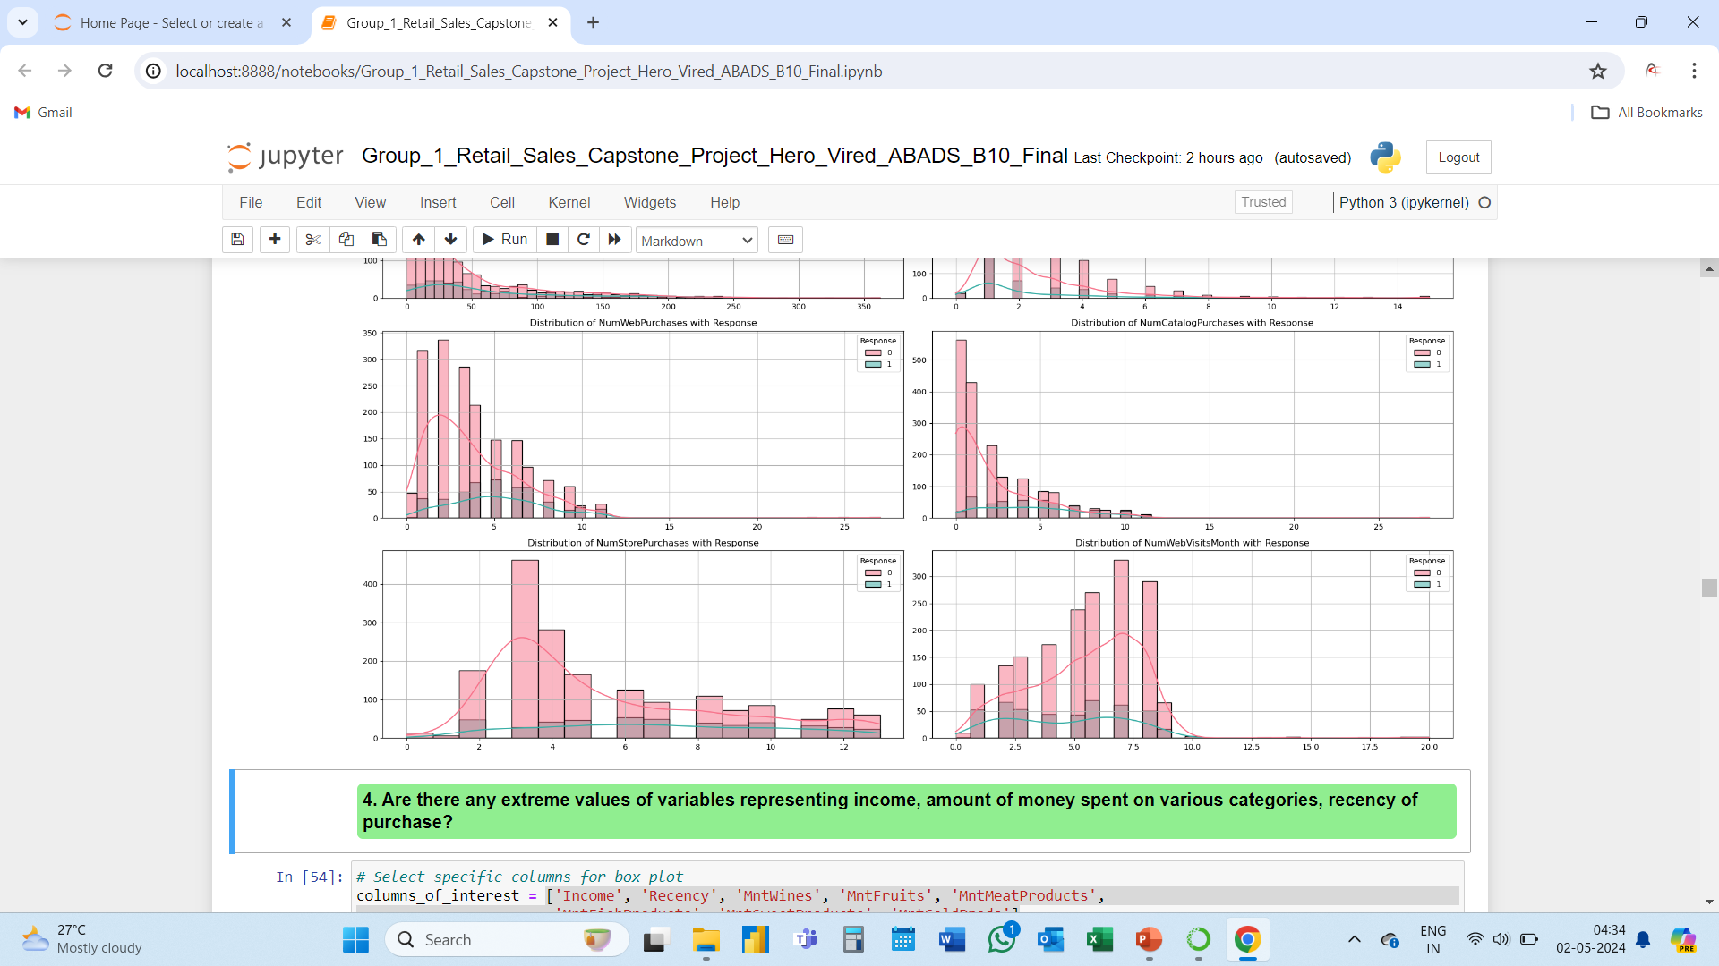

Slide 27
Response is not significantly impacted by number of store purchases by the customers.
Similarly, Response is not affected by the number of web visits in a month by a customer.

Slide 28
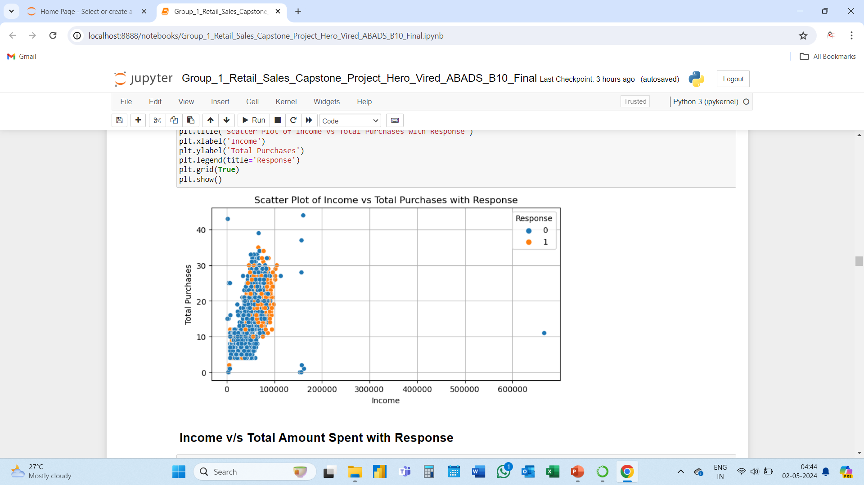
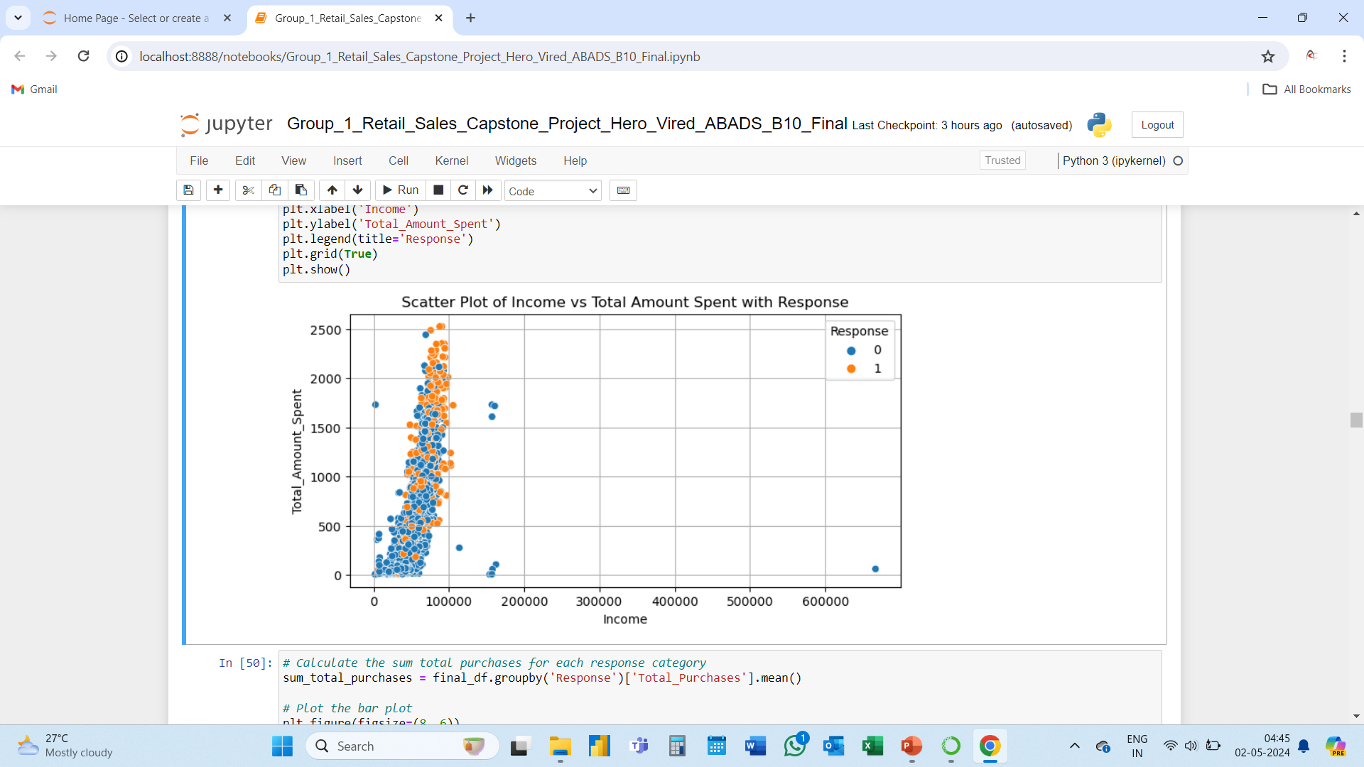

Slide 29
Income v/s Total Purchases v/s Responses – We can see the cluster of positive response belongs to customers who have purchased in between 10 to 30 items and have income in between $70K to $100K.
Income v/s Total Amount Spent v/s Responses – We can see the cluster of positive response belongs to the group of customers who spend above $1500 and have income in between $70K to $100K.

Slide 30
04
Generating Insights

Slide 31
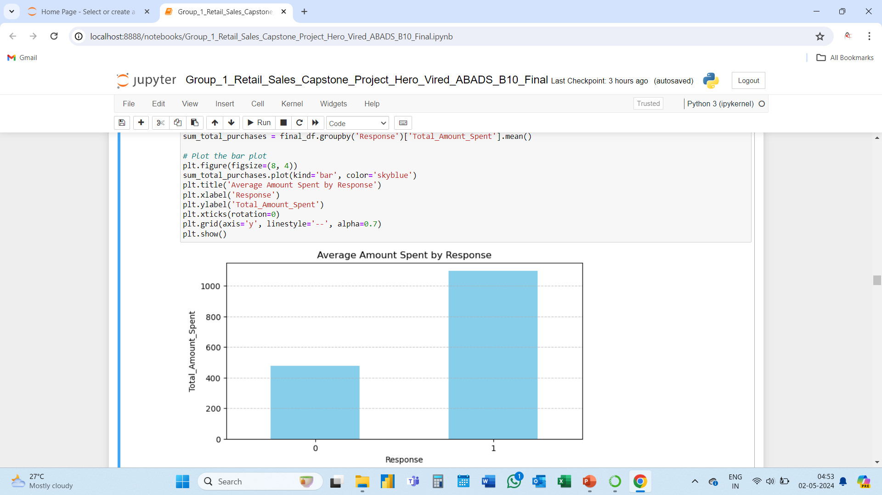
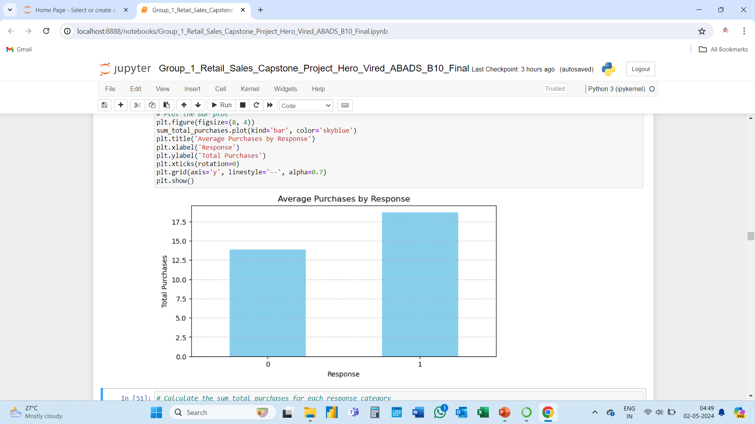
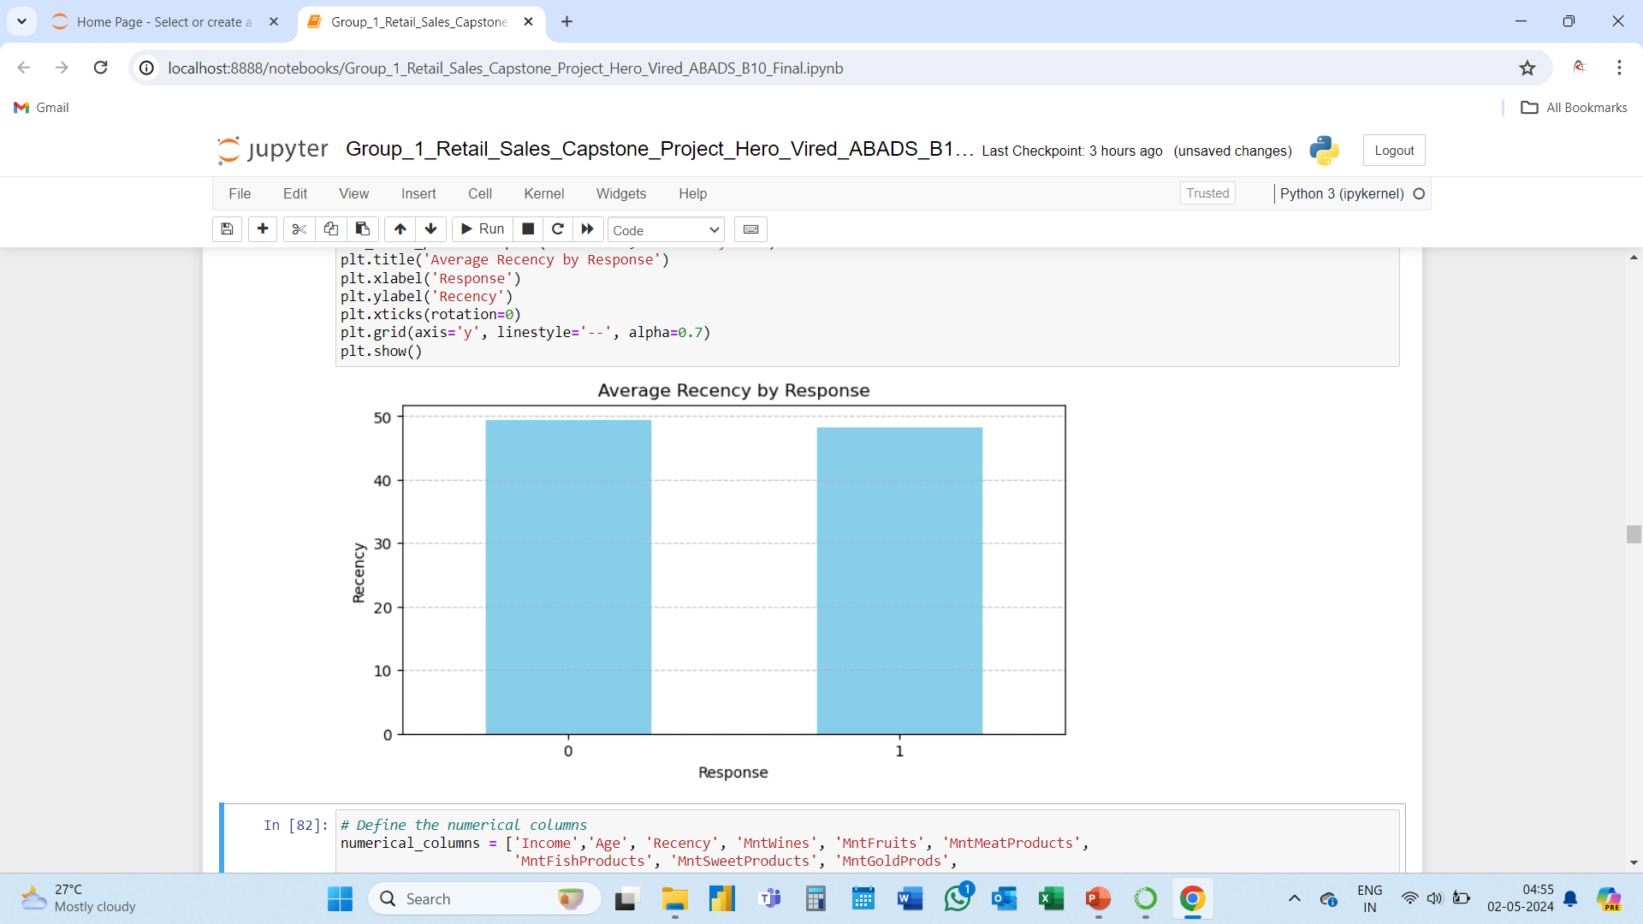
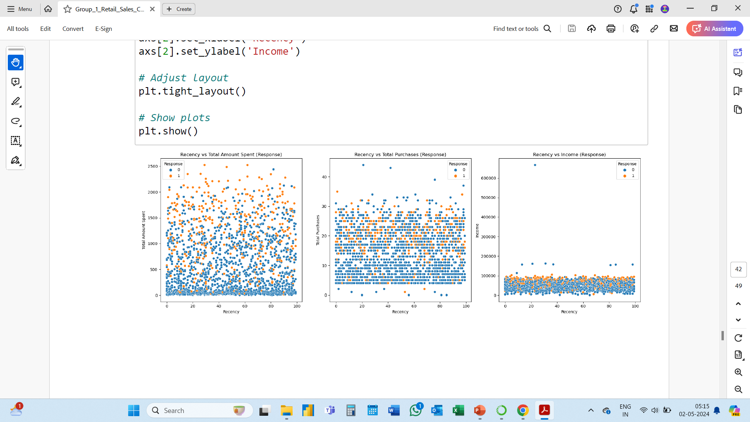

Slide 32
Average amount spent by customers who respond positively is significantly higher than who don’t.
Similarly average purchases made by people who respond positively is higher.
The recency has no impact on the response of customers.

Slide 33
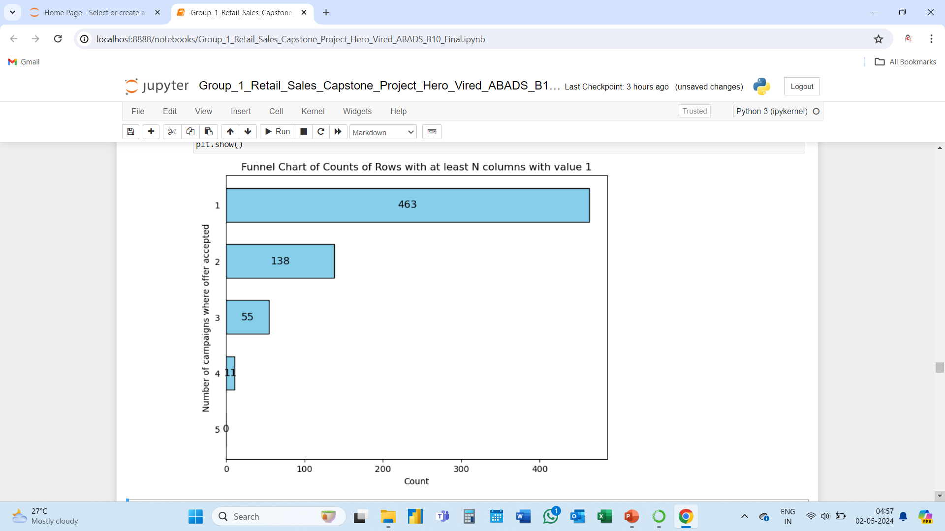
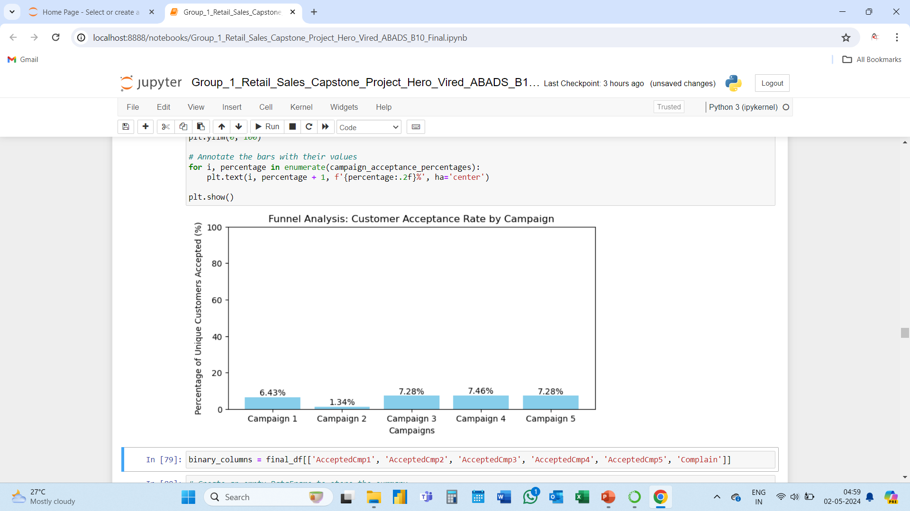
After accepting 1 campaign only 29% accept another campaign.
From 2nd campaign to 3rd the its 39%.
Only 20% of the customers have accepted total 4 campaigns.

Slide 34
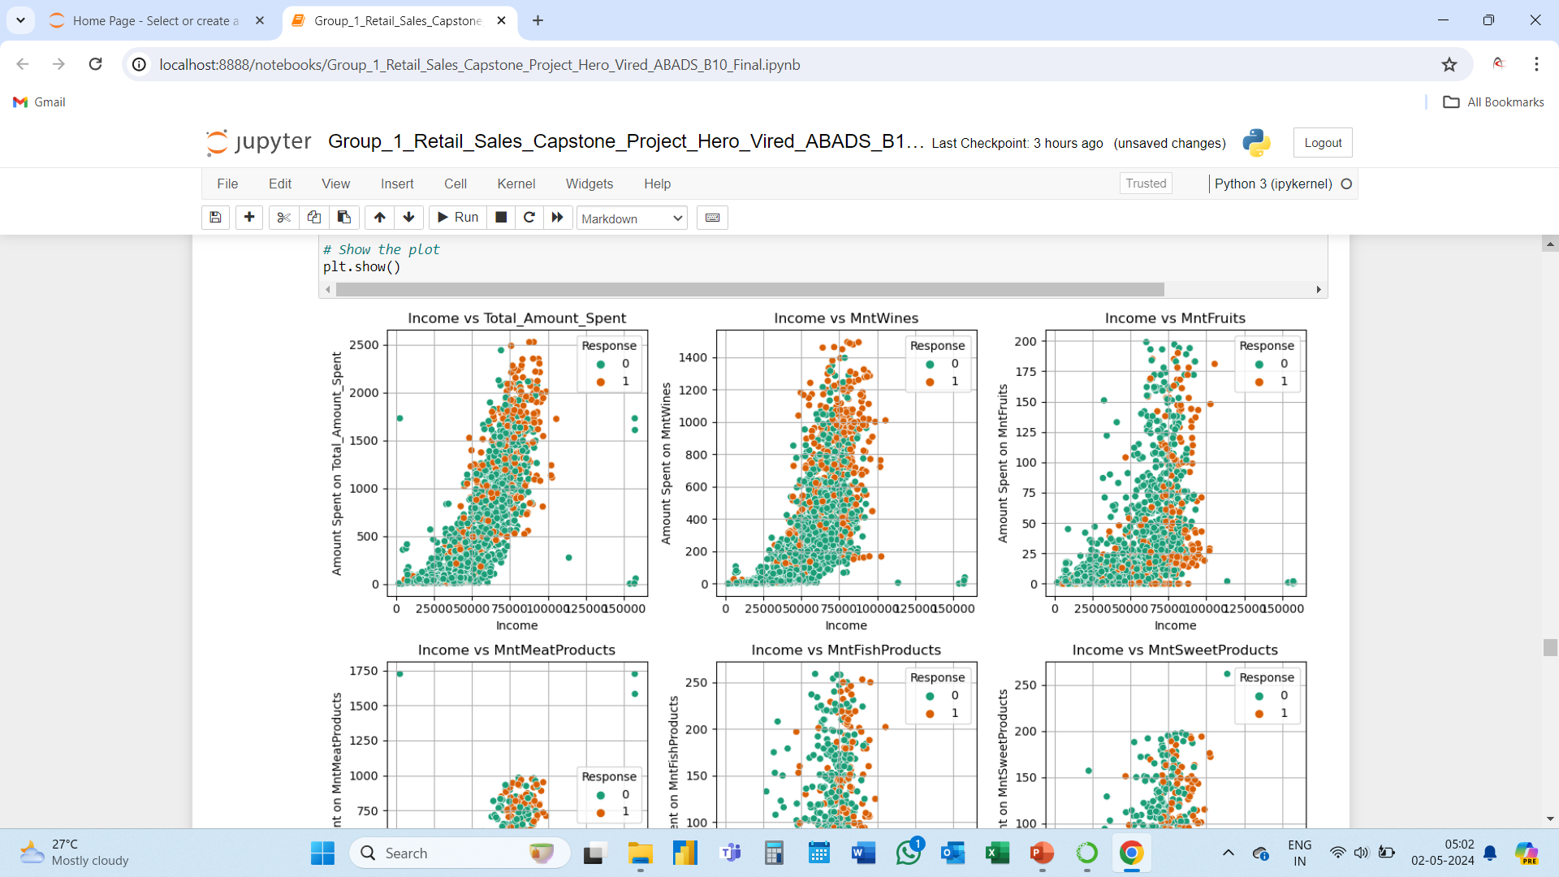
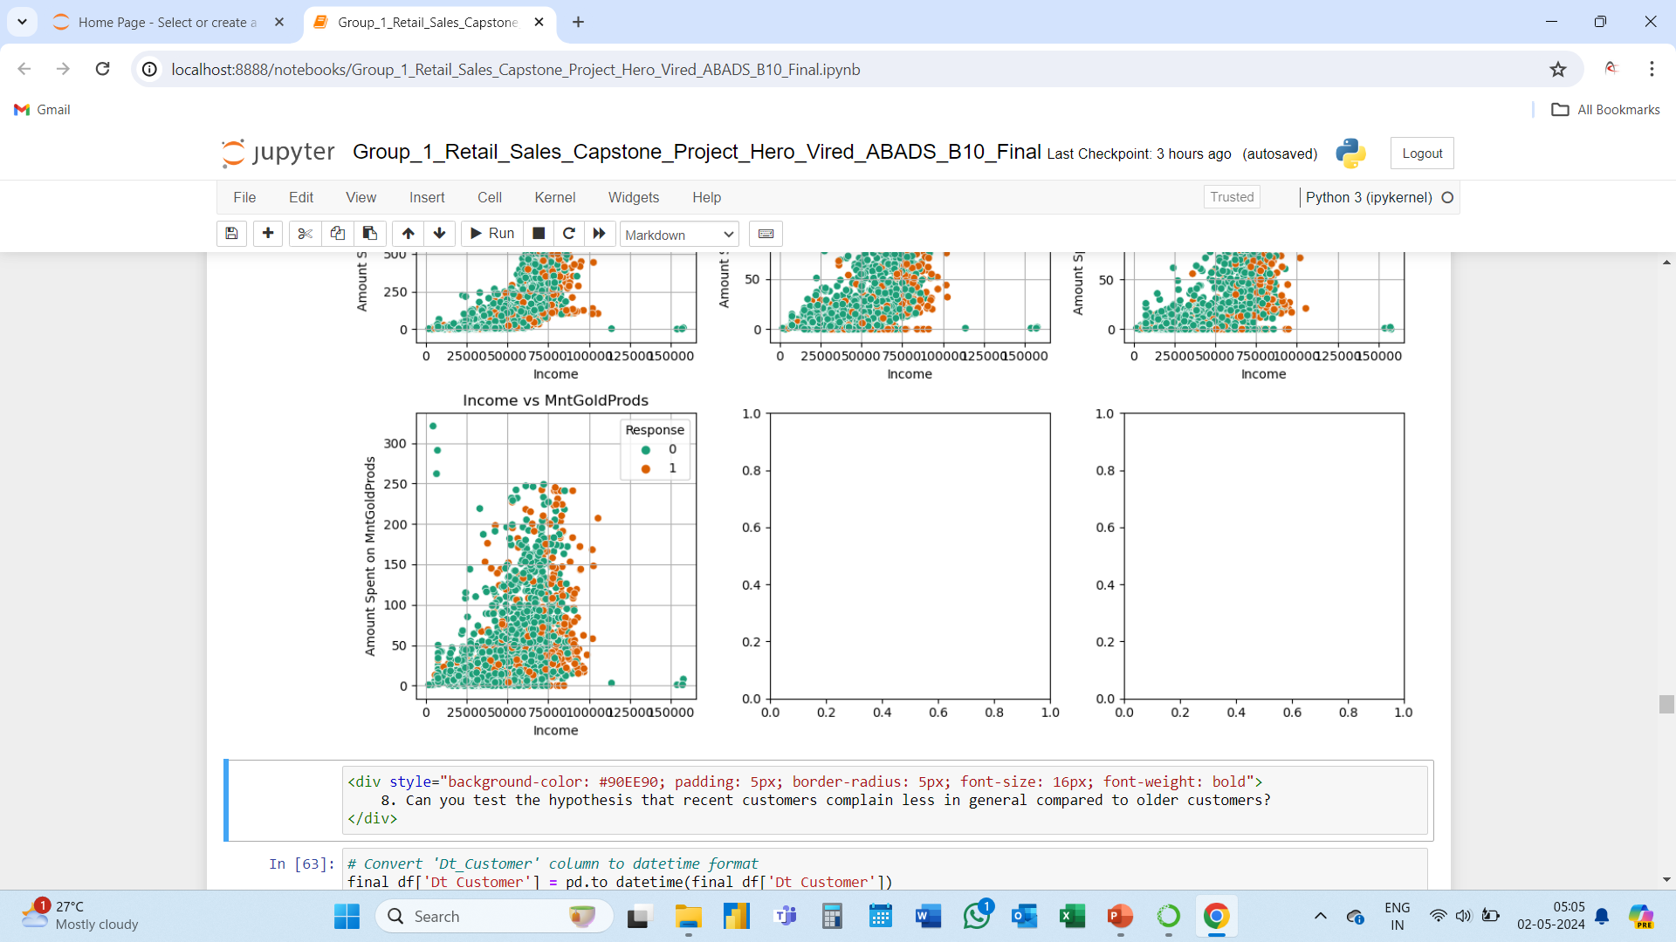
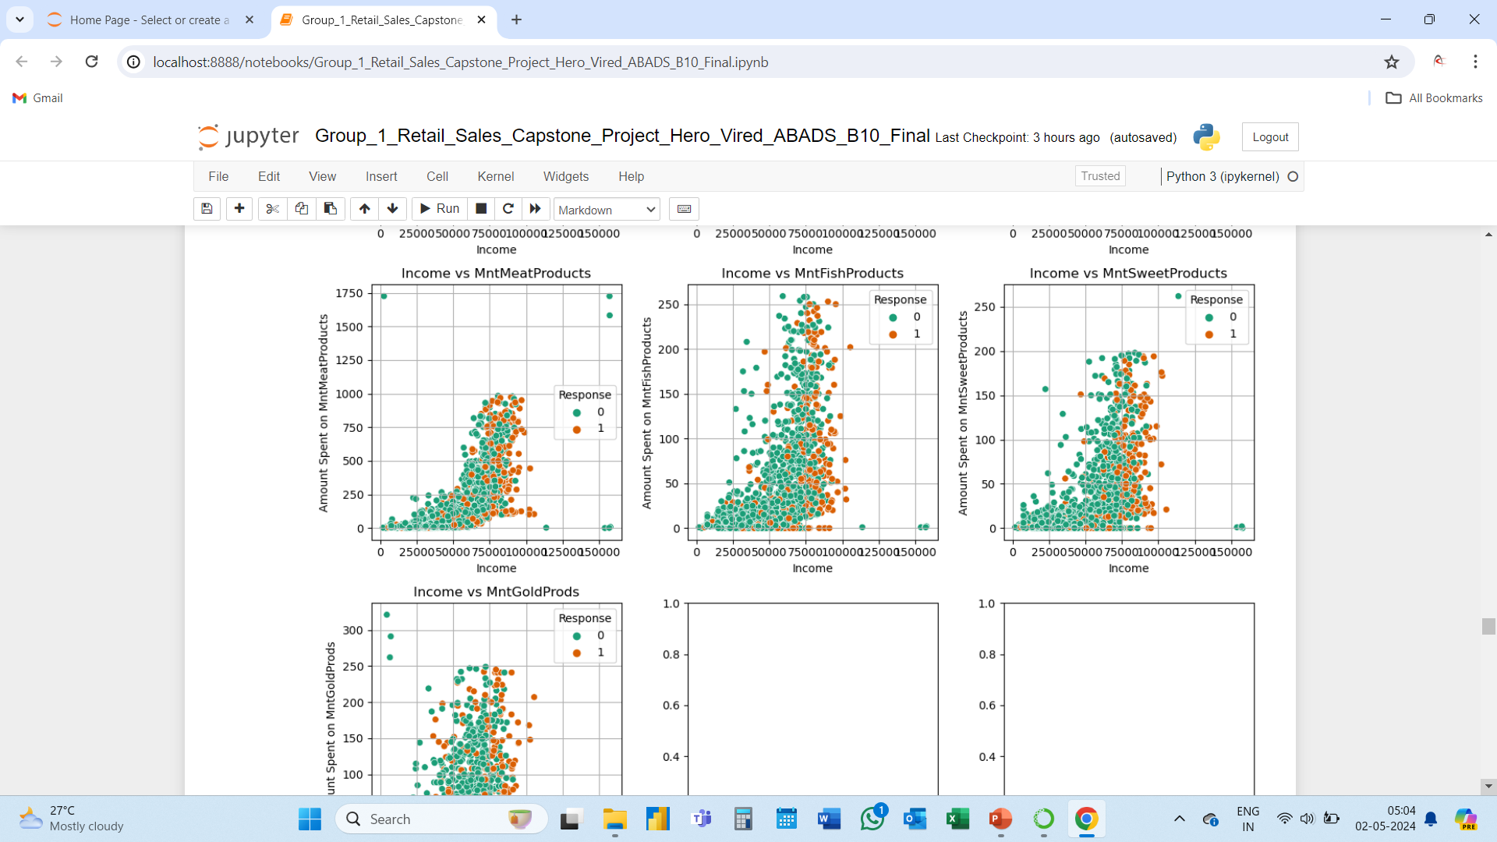

Slide 35
Amount spent on various products v/s Income v/s Response.
Cluster of customers responding positively is clearly visible for each product.

Slide 36
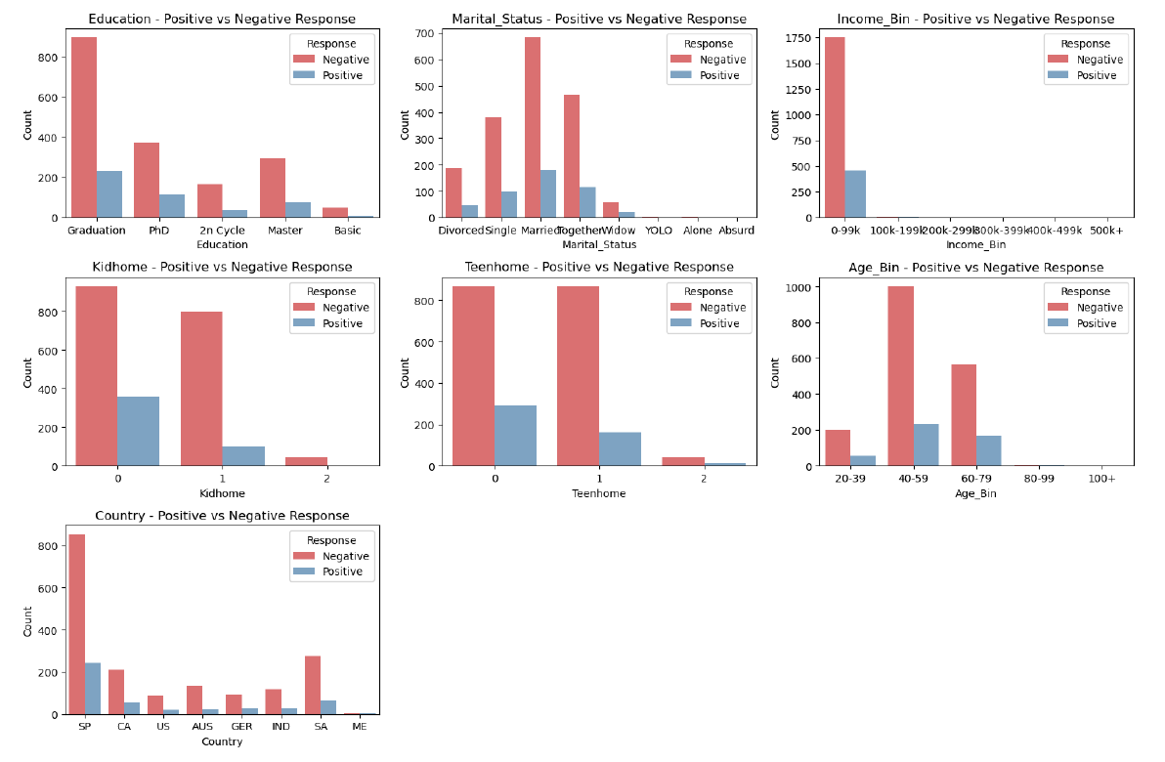
Profile of Respondents v/s Non-Respondents.

Slide 37
Business Analysis and Hypothesis (Task 2)
Profile of people who respond vs. who don’t.
The DataFrame was split up into people who responded as responders (1) and people who did not respond as non_responders (0).
responders = marketing[marketing['Response'] == 1]
non_responders = marketing[marketing['Response'] == 0]
Two attributes “Year_Birth” & “Income” were taken for analysis to those who responded and those who didn’t.
Descriptive Statistics was done for the attributes as those who responded vs those who didn’t.

Slide 38
The minimum and maximum value for Year_Birth for the responders was 1969 and 1996. Similarly the minimum and maximum value for Year_Birth for the non-responders was 1968 and 1996. The minimum and maximum value for Income for the responders was $7500 and $105471. Similarly the minimum and maximum value for Income for the non-responders was $1730 and $666666 respectively.
Statistics for Year_Birth:
Responders:
count 334.000000
mean 1969.416168
std 12.398192
min 1943.000000
25% 1959.000000
50% 1971.000000
75% 1979.000000
max 1996.000000
Name: Year_Birth,
Non-Responders:
count 1906.000000
mean 1968.698846
std 11.910143
min 1893.000000
25% 1959.000000
50% 1970.000000
75% 1977.000000
max 1996.000000
Statistics for Income:
Responders:
count 333.000000
mean 60209.675676
std 23194.080987
min 7500.000000
25% 39763.000000
50% 64090.000000
75% 80589.000000
max 105471.000000
Non-Responders:
count 1883.000000
mean 50839.132767
std 25252.804747
min 1730.000000
25% 34421.000000
50% 50150.000000
75% 66308.000000
max 666666.000000

Slide 39
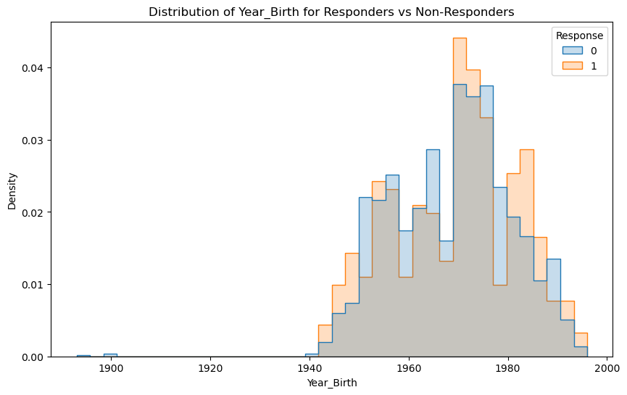
Distribution of Year_Birth for Responders vs Non-Responders
From the graph it can be concluded that people are responding to the campaign more than that of the Non-Responders.

Slide 40
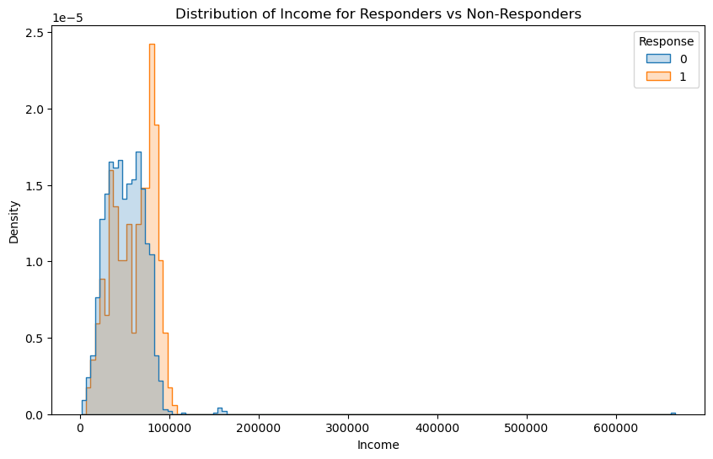
Distribution of Income for Responders Vs Non-Responders
From the graph it can be concluded that people with high income bracket are responding well to the campaign than the Non-Responders.

Slide 41
05
Hypothesis Testing

Slide 42
Hypothesis Testing
Hypothesis 1: Customers who spend more on wines are more likely to respond positively to marketing campaigns promoting wine-related products.
Hypothesis 2: Customers who spend more on fruits are more likely to respond positively to health-focused marketing campaigns.
Hypothesis 3: There is no significant relationship between the amount spent on meat products and the response rates in marketing campaigns.
Hypothesis 4: Customers who spend more on fish products are more likely to respond positively to marketing campaigns promoting seafood specials or cooking classes.
Hypothesis 5: There is a positive correlation between the amount spent on sweets and the response rates in marketing campaigns targeting family-oriented or holiday-themed promotions.
The amount spent on wines significantly differs between customers who responded and those who did not respond to marketing campaigns.

Slide 43
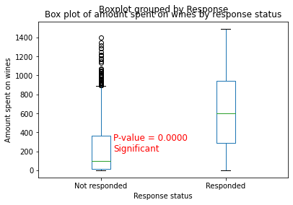
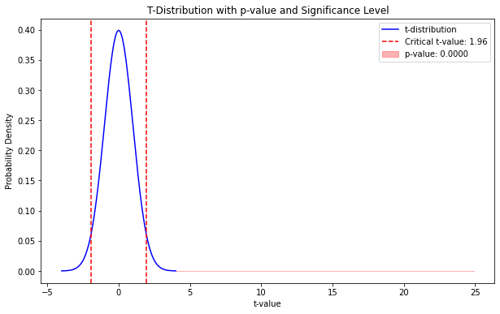
Hypothesis 1: Customers who spend more on wines are more likely to respond positively to marketing campaigns promoting wine-related products.
p value = 2.9561909421349646e-121 < significance value (0.05)
Reject the Null Hypothesis
The amount spent on wines significantly differs between customers who responded and those who did not respond to marketing campaigns.

Slide 44
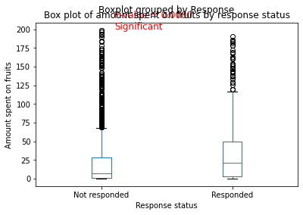
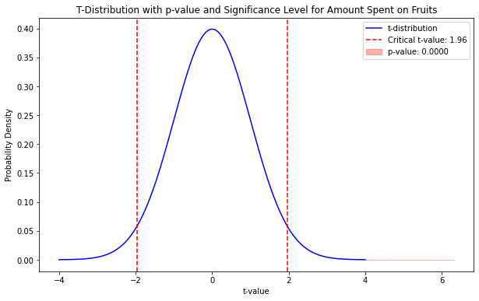
Hypothesis 2: Customers who spend more on fruits are more likely to respond positively to health-focused marketing campaigns.
the p value = 3.0950001315024603e-10 < 0.05
Reject the Null Hypothesis
The amount spent on fruits significantly differs between customers who responded and those who did not respond to marketing campaigns.

Slide 45
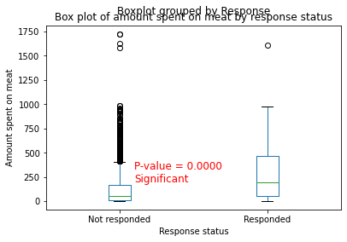
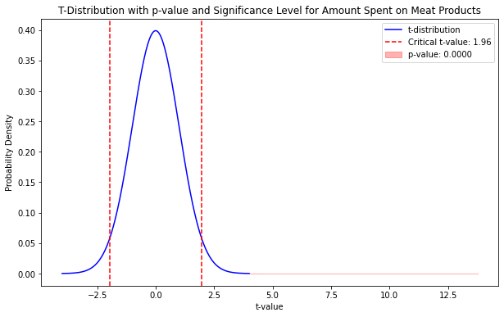
Hypothesis 3: There is no significant relationship between the amount spent on meat products and the response rates in marketing campaigns.
p value = 1.620540963756365e-41 < significance value (0.05)
Reject the Null Hypothesis
The amount spent on meat significantly differs between customers who responded and those who did not respond to marketing campaigns.

Slide 46
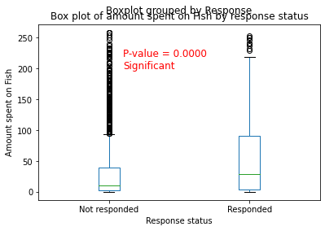
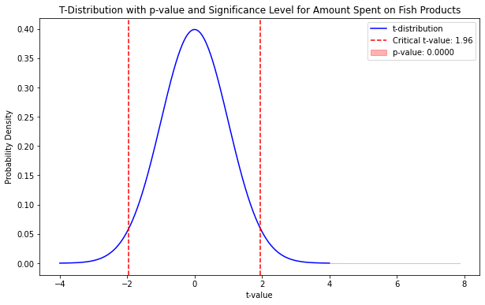
Hypothesis 4: Customers who spend more on fish products are more likely to respond positively to marketing campaigns promoting seafood specials or cooking classes.
p value = 5.351004838201368e-15 < significance value (0.05)
Reject the Null Hypothesis
The amount spent on fish significantly differs between customers who responded and those who did not respond to marketing campaigns.

Slide 47
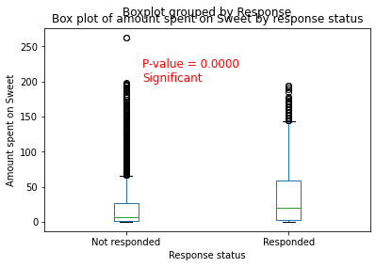
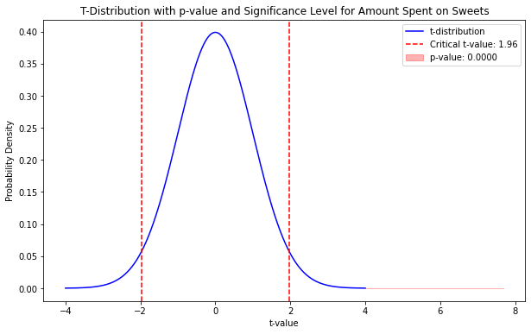
Hypothesis 5: There is a positive correlation between the amount spent on sweets and the response rates in marketing campaigns targeting family-oriented or holiday-themed promotions.
p value = 2.222422096548862e-14 < significance value (0.05)
Reject the Null Hypothesis
The amount spent on sweet significantly differs between customers who responded and those who did not respond to marketing campaigns.

Slide 48
06
Clustering & Its Analysis

Slide 49
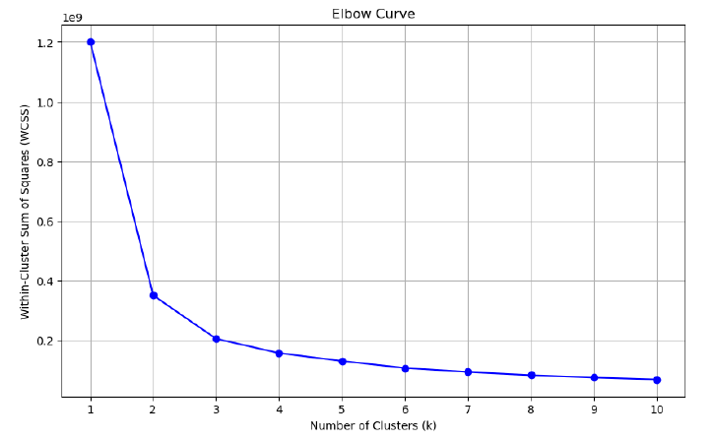
Identifying ideal number of cluster

Slide 50
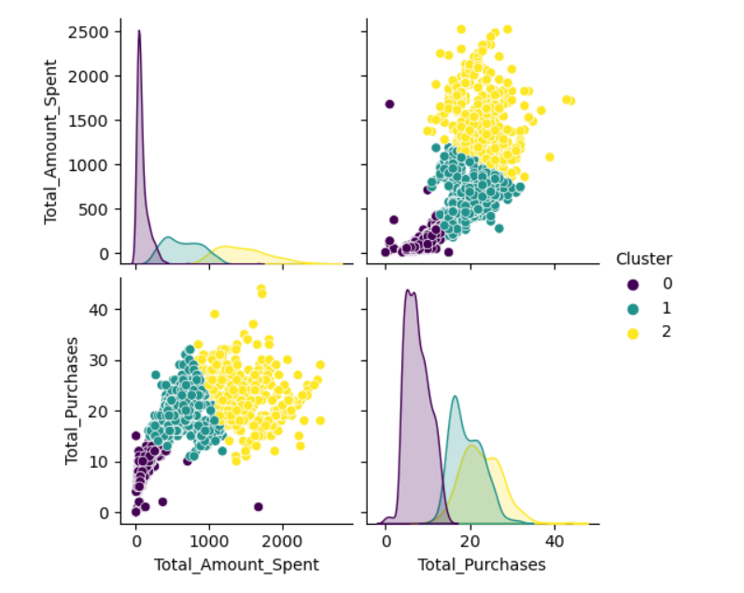
Broader clustering to understand segmentation
Understanding the Total amount spent and total purchases of different clusters.

Slide 51
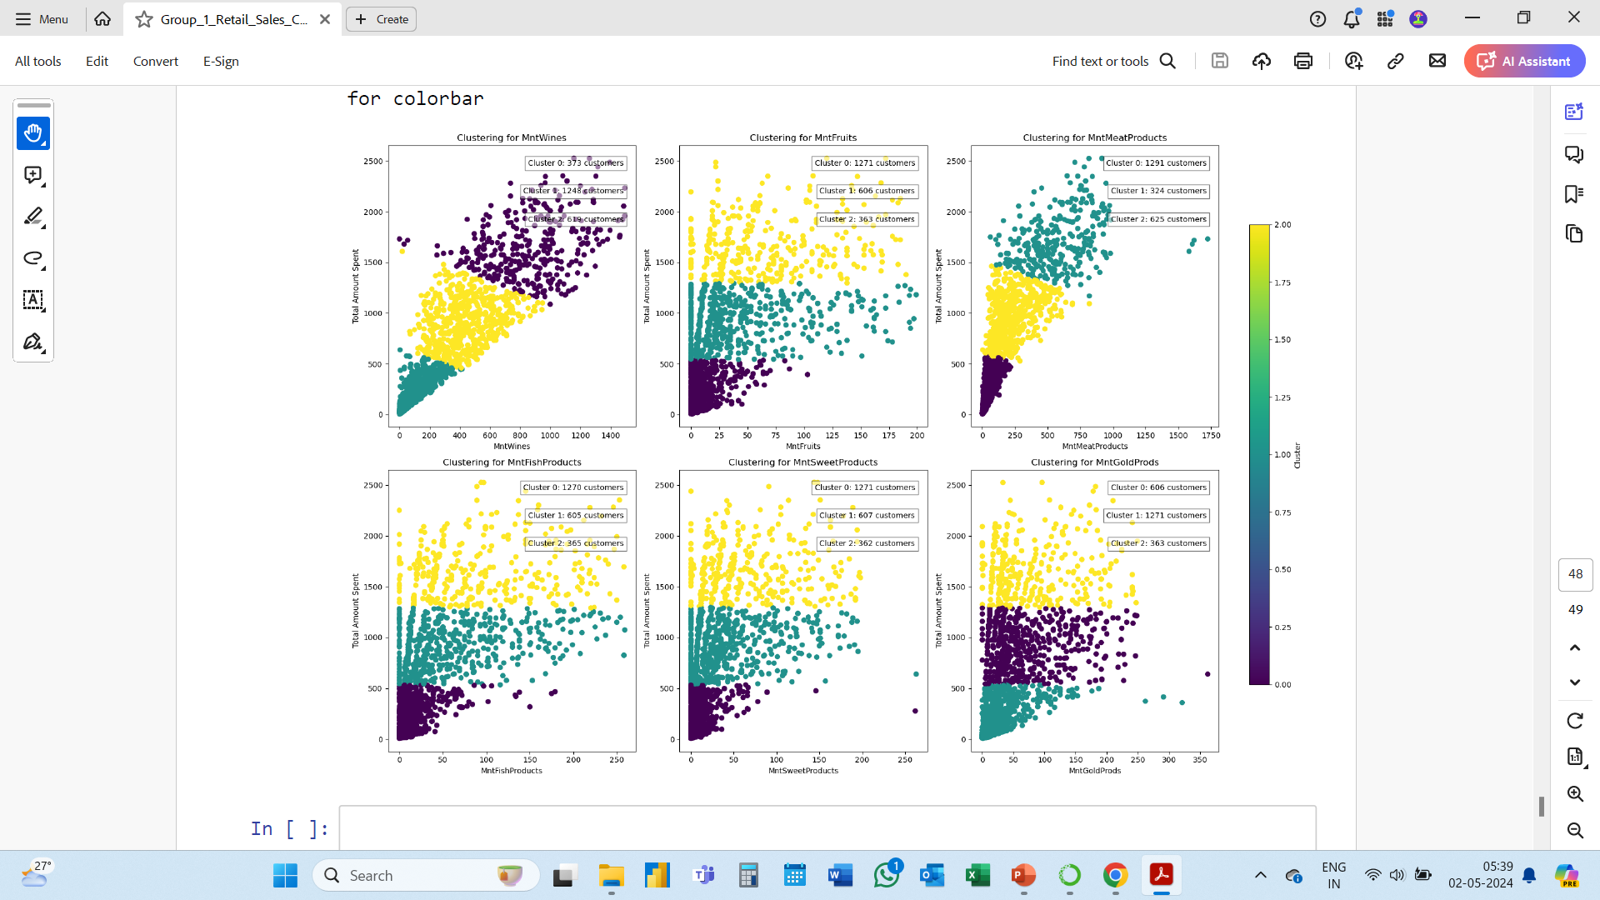
Product Wise Clustering To Plan Future Campaigns
On the basis of the number of customers in clusters product specific campaigns could be designed for better success.

Slide 52
THANK YOU..!

